Slide 1
DISNEY+HOTSTAR ANALYSIS

Slide 2
BRIEF DEFINITION
It is a video streaming platform offers TV shows movies and shows
It is available in several countries like India, Indonesia, Malaysiya, Thailand etc.,
It also offers live sports.
Initially it was hotstar and latter it integrated with disney and became disney+hotstar.

Slide 3
Introduction to data set
Movies and TV shows
Running time, movie description, genre
Age rating, number of episodes.
By observing this data set I can easily know say that favourite TV shows, favourite genre etc.,

Slide 4
PROBLEM STATEMENT
To know the insights and trends from the given dataset
To understood the distribution of movies by genre, running time, release year, age ratings.

Slide 5
TOOL USED
POWER BI DESKTOP
POWER POINT
USING POWER BI:
load>transformed>visualization>dashboard
USING POWER POINT:
Screen shot> paste it

Slide 6
DATA TRANSFORMATION

Slide 7
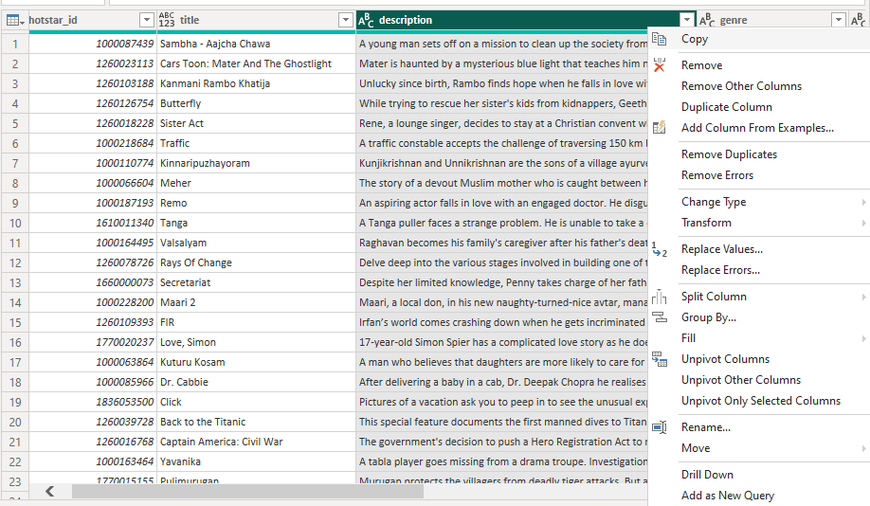
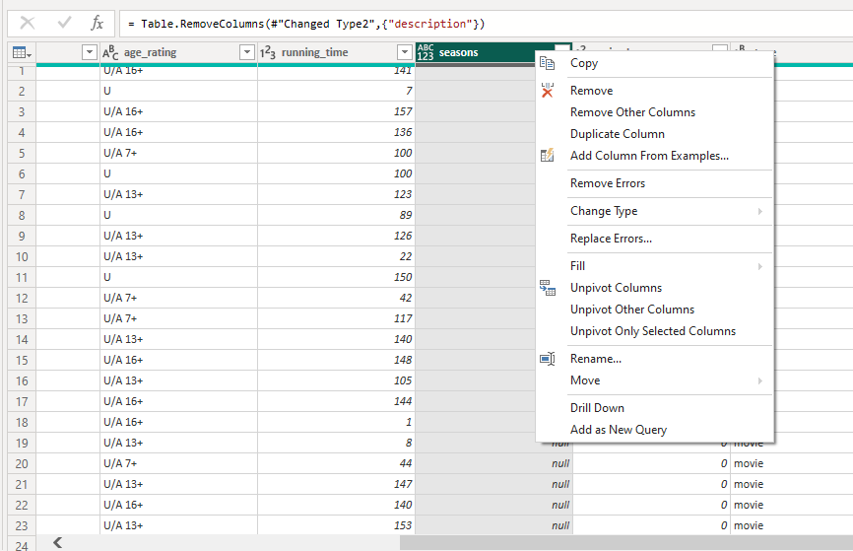
REMOVED COLUMN

Slide 8
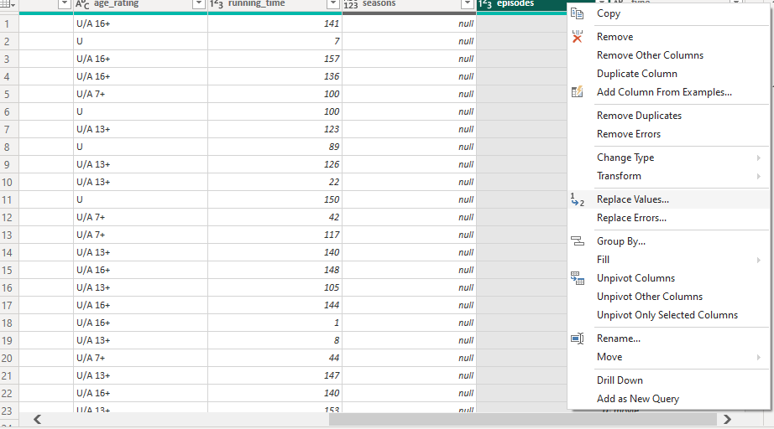
REPLACED VALUE

Slide 9
ANALYSIS

Slide 10
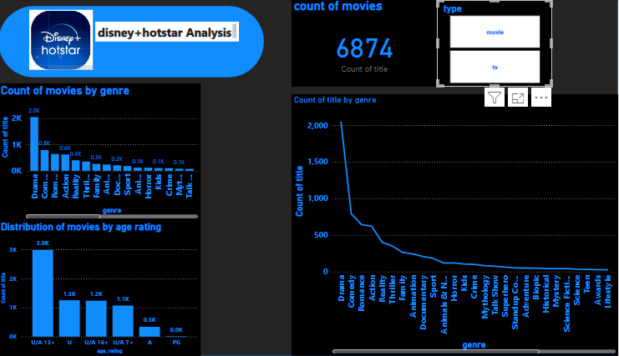
DASHBOARD 1

Slide 11
GENRE-WISE ANALYSIS
Distribution of movies based on its type
It clearly says that the genre drama, action, comedy takes the lead
Coming to age rating U/A 13 and U takes the lead

Slide 12
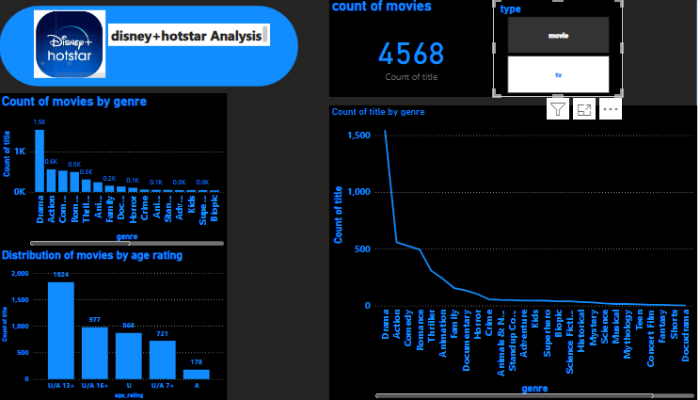
Movies

Slide 13
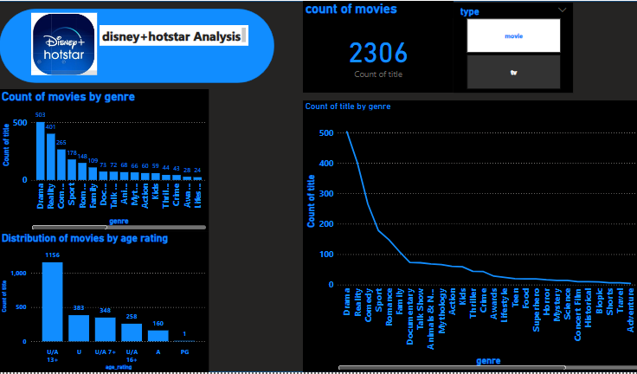
TV shows

Slide 14
MOVIES : 4568
Tv show: 2306
On comparision:
Movies have Drama, action, comedy
Tv shows have Drama, reality, comedy

Slide 15
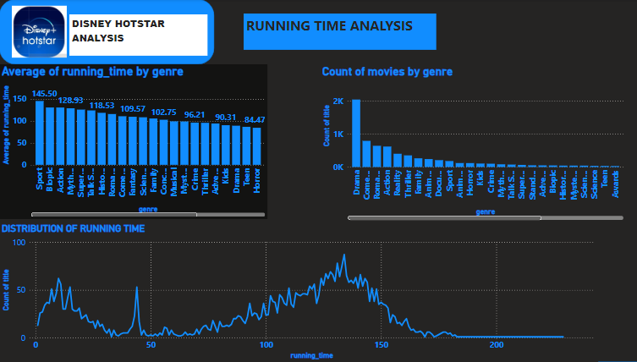
DASHBOARD 2

Slide 16
INSIGHTS
LONGEST : Drama and action genres have the longest average running times, suggesting they often more narratives or require extended screen time for action sequence.
Shortest: Family and animation genres typically have shorter running times, likely catering to younger audience.
Skewed distribution: The distribution of running times is skewed to the right, meaning there are more movies with shorter runtimes.

Slide 17
Peak around 100 minutes: The distribution has a peak around 100 minutes , indicating that many movies fall within this range.
Genre influences the running time.

Slide 18
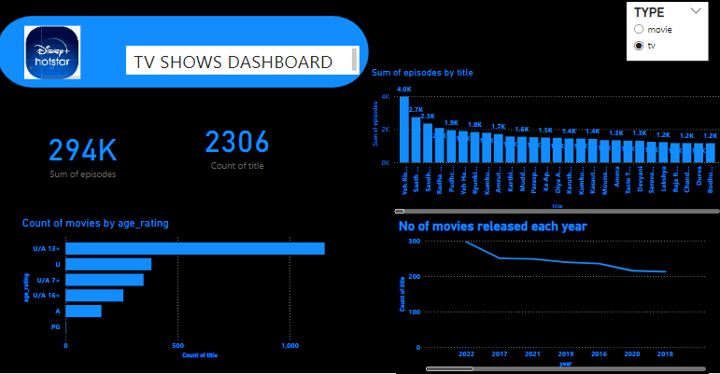
DASHBOARD 3

Slide 19
INSIGHTS
DASHBOARD: Provides comprehensive view of the TV show.
PLATFORM Boast a significant collection of TV shows with 294k episodes across 2306 shows.
EPISODE DISTRIBUTION: The histogram shows that a majority of titles have between 1k to 1.5k episodes, indicating a balanced distribution of content length.

Slide 20
Age Rating distribution : “U/A 13” s the most common age ratting, followed by “U/A 7”.
Movie release trends: The line chart reveals a declining trend in the number of movies released each year from 2015 to 2021. This could be due to various factors such as changes in content strategy.

Slide 21
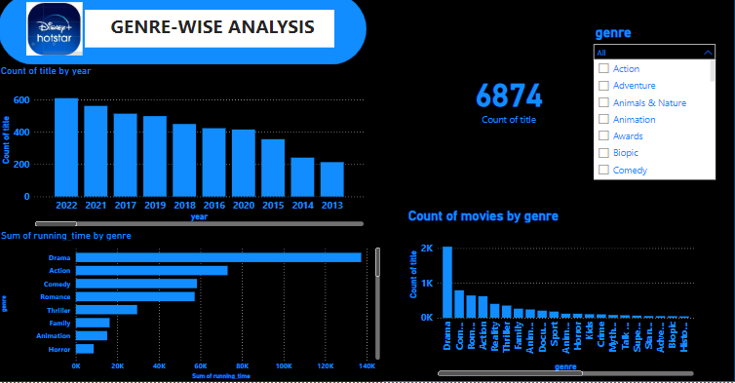
DASHBOARD 4

Slide 22
INSIGHTS
Dashboard provides TV shows and movies genre wise distribution on hotstar.
GENRE DOMINANCE: Action and drama are the most popular genre this suggest that there is demand for action packed and adventure content.
GENRETRENDS: The count of year by titles by year shows show a consistent pattern with Action and adventure maintaining their dominance over time.
RUNNING TIME ANALYSIS: Drama and action have the highest sum of running time, indicating that they are the most prominent genres in terms overall content duration.
GENRE DIVERSITY: While Action and adventure lead, the dashboard reveals a divers range.

Slide 23
RECOMMENDATIONS
U/A 13 + and U/A 7+ is most prevalent age rating whereas U/A 16+ AND U ratings are less common.
As these 13+ and 7+ took the dominance it suggest that there is a need in concentrating family friendly and teen oriented content.
PG and A rated shows are less it indicates there is a content gap and it misses that particular audience .
The popularity of certain titles with higher number of episodes might indicate strong fanbase .

Slide 24
Action and drama took the dominance disney + hotstar should consider expanding it to other genre to cater to wider audience.
Low number of family, animation, and horror might present opportunities to fill content gaps and attract specific audience.

Slide 25
Thank you

